Slide 1

Air pollution monitoring, forecasting and controlling system
BMS College of Engineering
Department of Information Science and Engineering
CAPSTONE PROJECT PHASE -2
Review - II
Batch No:- 25
Project Team Members:
Prateek M Gummaraju (1BM19IS117)
Ruchi Agarwal (1BM19IS133)
Samartha S (1BM19IS219)
Under the Guidance of
Prof. Pallavi B
Assistant Professor
Department of ISE

Slide 2
Agenda
Introduction
Problem Statement
Proposed System
System Design
Methodology
Technology Stack
Implementation
Testing
Results
Conclusion
Future Enhancement
Project Outcome
References

Slide 3
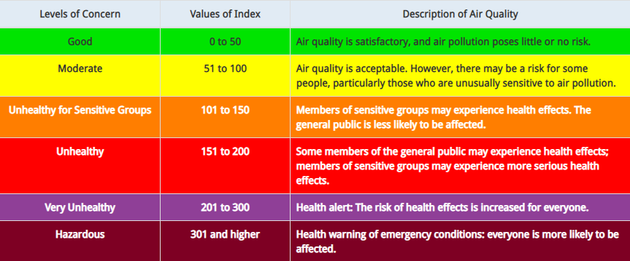
Introduction
Air pollution is defined as the presence of compounds in the atmosphere that are harmful to human beings and other living organisms
Has severe effects on human health - Respiratory issues, lungs and heart problems
Offering a holistic approach to tackle the issue of air pollution by building a device that can monitor air pollution, predict future levels of pollution and also suggest precautionary actions and methods to reduce air pollution

Slide 4
Problem Statement
To build an intelligent and automated device that has the ability to monitor, forecast and also control air pollution by leveraging booming technologies like IoT and Data Science

Slide 5
Proposed System
We would like to propose a implementation with which, we hope to demonstrate the viability of a low-cost, Internet of Things based system constructed using Arduino and a variety of sensors that can not only monitor the current air quality but also predict the future and offer recommendations on how to reduce pollution and protect people from dangerous pollutants. We hope this system will help regulate and bring down the levels of air pollution and improve the quality of air, which in turn will improve the quality of lives of humans.
There are 3 modules: Monitoring, Forecasting and Controlling
We have a web application that will be available publicly for all users to use.

Slide 6
Objectives
Build an IoT system to monitor Air Quality:
  a) Monitor Concentrations of different air pollutants
  b) Measure AQI
Build a model to predict the Air Quality in the near future, using the output of the IoT system as input.
Build a web application to display the real time findings.
Provide analytics on the website, such as the maximum recommended limit and the current concentration.
Provide measures to improve Air Quality.
Provide precautionary measures.
Bring about air pollution awareness

Slide 7
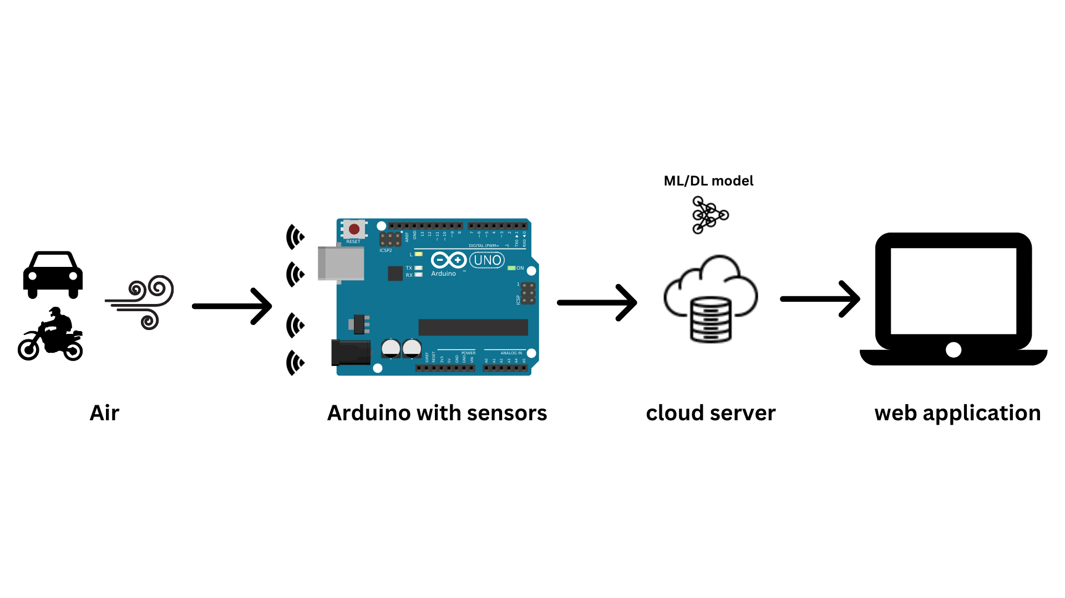
SYSTEM DESIGN
System Architecture

Slide 8
Methodology
Our system will have 3 parts:
1. Monitoring
An IoT device will be built using Arduino as the microcontroller. We will use MQ135 Air Quality sensor, MQ131 Ozone sensor, MQ7 Carbon Monoxide sensor, DHT11 sensor and PM2.5 dust sensor. These sensors will measure the current concentrations of the various pollutants and will output the current AQI. The values of the concentrations of the gases is to be stored in a database, which will be used to forecast the future levels of AQI.
2. Forecasting
Using the data collected in the previous module, an ML model is to be trained to predict the future levels of AQI. Based on the literature survey, the AutoRegression model provided the best results.
3. Controlling
AQI is categorized into 6 categories based on the value. Depending on the category of the current AQI level, suggestions are to be provided to improve the category to ‘Good’.

Slide 9
Technology Stack
1. IoT
Arduino IDE, Physical IoT components like Arduino UNO, NodeMCU, breadboard, connecting wires, and a variety of sensors
2. Data Science
Google Colab, Jupiter Notebook
3. Web Development
HTML, CSS, JavaScript, PHP, SQL Database.

Slide 10
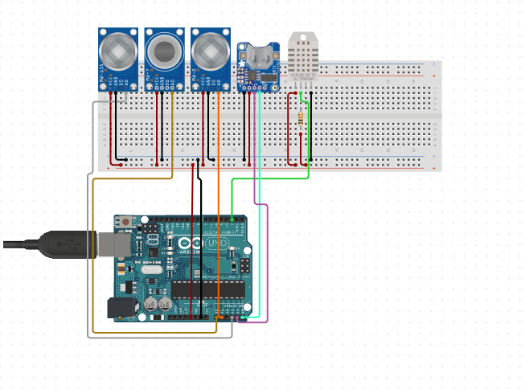
Implementation
Hardware Used:
Arduino UNO
DHT11 Sensor
MQ135 Air Quality Sensor
MQ131 Ozone Sensor
MQ7 CO Sensor
GP2Y1010AU0F
Dust Smoke Particle Sensor
Node MCU

Slide 11
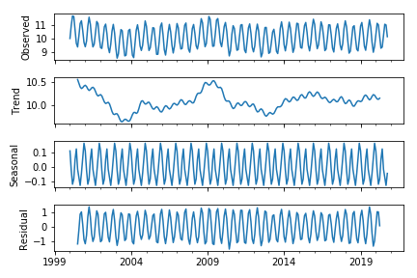
Implementation
Data Science Models explored:
AutoRegressive(AR) models are a subset of time series models, which can be used to predict future values based on previous observations. AR models use regression techniques and rely on autocorrelation in order to make accurate predictions.

Slide 12
Implementation
Data Science Models explored:
ARIMA:
Autoregression (AR): refers to a model that shows a changing variable that regresses on its own lagged, or prior, values.
Integrated (I): represents the differencing of raw observations to allow the time series to become stationary (i.e., data values are replaced by the difference between the data values and the previous values).
Moving average (MA): incorporates the dependency between an observation and a residual error from a moving average model applied to lagged observations.
SARIMA:
An extension to ARIMA that supports the direct modeling of the seasonal component of the series is called SARIMA.
12

Slide 13
Testing (Minimum 5 slides)
Tell about
Test cases carried out for:
Unit/Module Testing
Integration Testing
System Testing

Slide 14
Results
Based on our experimentation, ARMAX model with (p,q,d) = (4,0,1) and exogenous variables being Average Temperature, Relative Humidity and Diwali gave us the best results, going by Mean Squared Error.
MODEL (Parameters) | MSE
Predicting based on previous day | 577.05
AutoReg(lags=17, trend=’t’) | 917.961
ARMA: ARIMA(p=4, d=0, q=1, trend=’t’, exog=Null) | 449.86
ARIMA(p=3, d=1, q=1, trend=’t’, exog=Null) | 450.586
ARMAX(p=4,d=0,q=1, trend=’t’, exog=[‘Average Temperature’]) | 421.21
ARMAX(p=4,d=0,q=1, trend=’t’, exog=[‘Average Temperature’,’Diwali’]) | 320.125
ARMAX(p=4,d=0,q=1, trend=’t’, exog=[‘Relative Humidity’,’Wind Direction’]) | 376.463
ARMAX(p=4,d=0,q=1, trend=’t’, exog=[‘Average Temperature’,’Diwali’,‘Relative Humidity’,’Wind Direction’,’Barometric Pressure’]) | 295.075
ARMAX(p=4,d=0,q=1, trend=’t’, exog=[‘Average Temperature’,’Diwali’,‘Relative Humidity’]) | 279.228

Slide 15
Future Enhancement
Integrating the AQI forecast into Google Maps. Just like how Google gives push notifications of the weather rain forecast, it should give AQI forecasts as well.
Automating the complete line of work, the device and model should work without any human interference, except for maintenance.
We have built only one IoT device and have implemented it in only one location. Once we have established the proof of concept with this one location, we hope we can implement this on a much larger scale, covering much larger areas.

Slide 16
Project outcome
Competition
KSCST Student Project Program - Selected and funded
Research Paper
Published in IJNRD

Slide 17
Conclusion
Air pollution is a very challenging and complex problem that requires a multifaceted solution. To tackle this complex issue, we are proposing the implementation of a holistic approach to tackle air pollution. Through the proposed system, we not only aim to reduce the levels of air pollution, but also positively impact the lives of people by helping them change their lifestyle in such a way that it will encourage them to adopt some habits that will help reduce air pollution, which will help them, their pets and their environment to be healthier. We are leveraging the capabilities of powerful technologies like IoT and ML to build a system that will fight against the harmful effects of air pollution and make the world a better place to live in.

Slide 18
References
[1] Ayele, Temesegan Walelign, and Rutvik Mehta. "Air pollution monitoring and prediction using IoT." 2018 second international conference on inventive communication and computational technologies (ICICCT). IEEE, 2018.
[2] Balasubramanian, Ssneha, Sneha, Talapala, B, Vinushiya and S, Saraswathi. "Air Pollution Monitoring and Prediction using IOT and Machine Learning." (IJCSIT) International Journal of Computer Science and Information Technologies, Vol. 12 (2), 2021.
[3] Bhalgat, Pooja, Sachin Bhoite, and Sejal Pitare. "Air quality prediction using machine learning algorithms." International Journal of Computer Applications Technology and Research 8.9 (2019): 367-370.
[4] Tomar, Nimisha, Durga Patel, and Akshat Jain. "Air Quality Index Forecasting using Auto-regression Models." 2020 IEEE International Students' Conference on Electrical, Electronics and Computer Science (SCEECS). IEEE, 2020.
[5] De Vito, Saverio, et al. "Adaptive machine learning strategies for network calibration of IoT smart air quality monitoring devices." Pattern Recognition Letters 136 (2020): 264-271.
[6] Meivel S, Mahesh M, Mohnish S, Mukesh Pandian S, “Air Pollution Monitoring System Using IOT And Artificial intelligence”, IJMA, vol. 10, no. 2, pp. 3085 - 3089, May 2021.

Slide 19
References
[7] Kumar, Anikender, and P. Goyal. "Forecasting of daily air quality index in Delhi." Science of the Total Environment 409.24 (2011): 5517-5523.
[8] Zhu, Suling, et al. "Daily air quality index forecasting with hybrid models: A case in China." Environmental pollution 231 (2017): 1232-1244.
[9] Zhang, Dan, and Simon S. Woo. "Real time localized air quality monitoring and prediction through mobile and fixed IoT sensing network." IEEE Access 8 (2020): 89584-89594.
[10] Moses, Leeban. "IoT enabled Environmental Air Pollution Monitoring and Rerouting system using Machine learning algorithms." IOP Conference Series: Materials Science and Engineering. Vol. 955. No. 1. IOP Publishing, 2020.
[11] Kumar, Somansh, and Ashish Jasuja. "Air quality monitoring system based on IoT using Raspberry Pi." 2017 International conference on computing, communication and automation (ICCCA). IEEE, 2017.
[12] Mao, Wenjing, et al. "Modeling air quality prediction using a deep learning approach: Method optimization and evaluation." Sustainable Cities and Society 65 (2021): 102567.

Slide 20

12

Slide 21

13

